Slide 1
Data Structures and Algorithms -3 (25CS2103E)
Title of the project:
Parallel TextHack Search Engine
Team Members
S.Harshith:2520030572
M.Nityay Varma:2520030618
Under the Esteemed Guidance of
DR.CH.ANURADHA-Assistant Professor(CSE)

Slide 2
Contents
Abstract
Introduction
Literature survey
Problem Statement and Objectives
Hardware and Software requirements
Results
Conclusion
Future Scope

Slide 3
Abstract
A search engine for searching large collections of text documents. Supports sequential and parallel searching.
Uses advanced string-matching algorithms such as:
  KMP
  Z Algorithm
  Rabin-Karp
  Aho-Corasick
Supports multiple document formats:
  TXT
  PDF
  DOCX
  CSV
Uses multiple threads to process document partitions simultaneously. Combines partial results using parallel reduction.
Evaluates:
  Execution time
  Throughput
  Speedup
  Efficiency
  Scalability

Slide 4
Introduction
Rapid growth of digital documents has increased the need for efficient searching.
Sequential search becomes expensive for large document collections.
String-matching algorithms improve search efficiency.
Parallel processing enables simultaneous document searching.
Our system provides both:
  Sequential Search
  Parallel Search
Performance is measured and compared.

Slide 5
Literature Survey
Existing Approach | Technique | Limitation
Naive String Matching | Character-by-character comparison | High time complexity
KMP | Prefix/LPS preprocessing | Mainly single-pattern searching
Rabin-Karp | Rolling hash | Hash collisions require verification
Aho-Corasick | Trie + failure links | Higher memory requirement
Traditional Sequential Search | One document at a time | Slow for large datasets
Parallel Search | Multiple workers | Synchronization/reduction required
Search Engines | Indexing and ranking | Complex infrastructure

Slide 6
Literature Survey-Comparsion Algorithm
String Matching Algorithms:
Algorithm | Main Idea | Complexity
Naive | Direct comparison | O(nm)
KMP | LPS preprocessing | O(n+m)
Z Algorithm | Z-array preprocessing | O(n+m)
Rabin-Karp | Rolling hash | Expected O(n+m)
Aho-Corasick | Trie + failure links | O(n + total pattern length + matches)

Slide 7
Problem Statement and Objectives
Problem Statement
To develop a search engine capable of efficiently searching large document collections using advanced string-matching algorithms and parallel processing techniques.
System should:
Accept large document collections.
Support multiple document formats.
Search for one or more keywords.
Support sequential and parallel execution.
Partition documents among multiple threads.
Combine partial results using parallel reduction.
Rank matching documents.
Measure search performance.
Display graphical performance comparisons.

Slide 8
Problem Statement and Objectives
Objectives
Develop an efficient document search engine.
Implement advanced string-matching algorithms.
Support exact, phrase, multi-keyword, and fuzzy searching.
Implement sequential and parallel search modes.
Partition large datasets among processing threads.
Combine partial results using parallel reduction.
Measure execution time and throughput.
Calculate speedup and efficiency.
Analyze scalability with different thread counts.
Provide a user-friendly search dashboard.

Slide 9
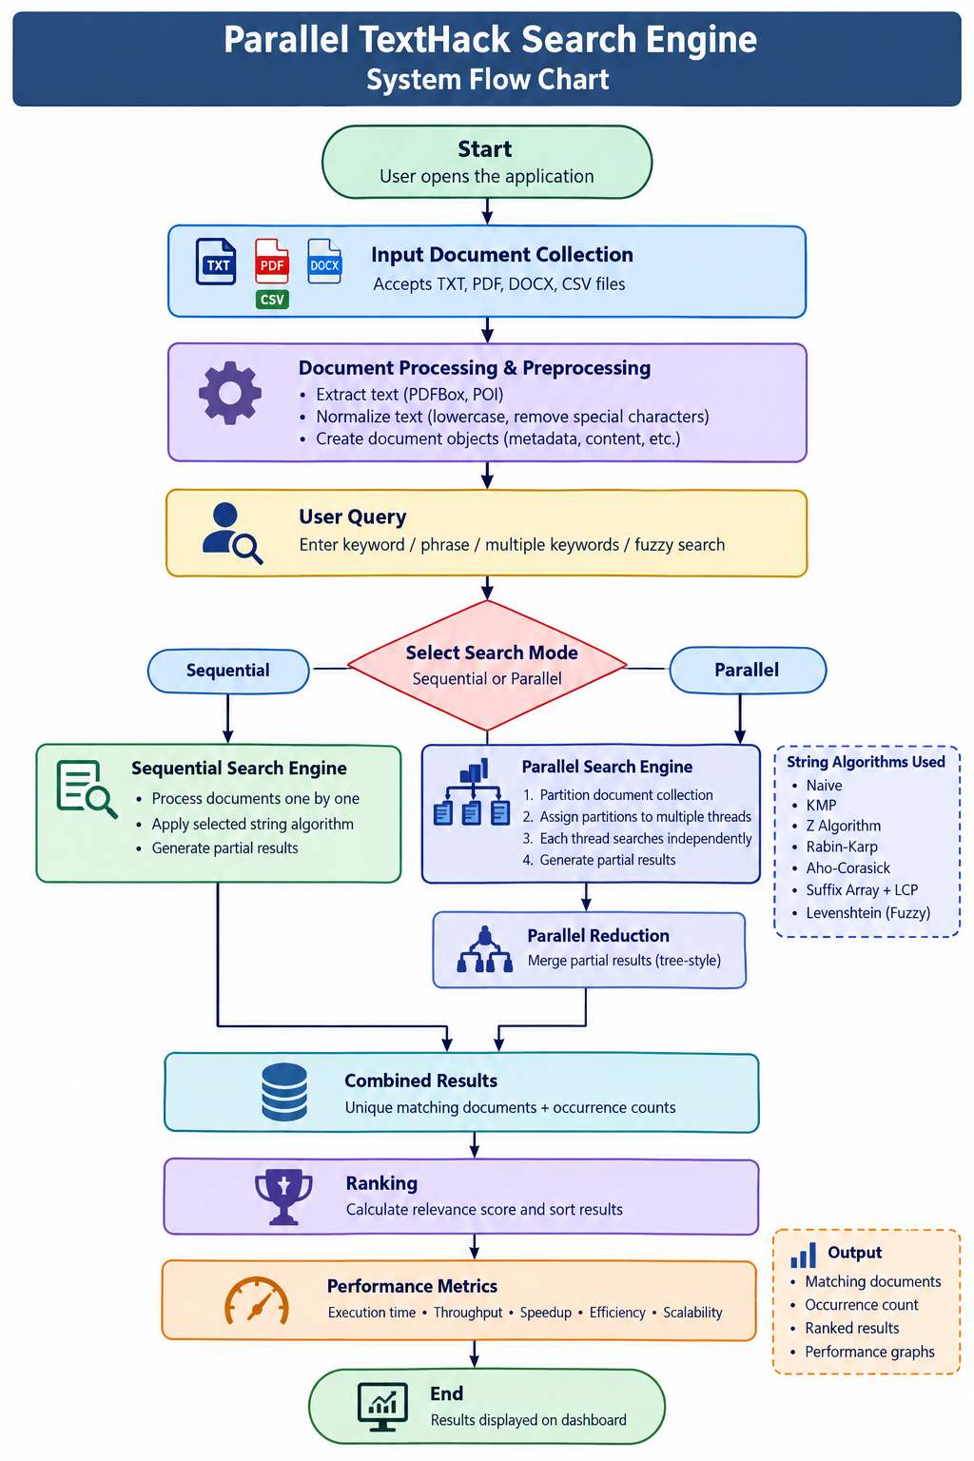
Flow Chart

Slide 10
Results
Algorithm Performance: Advanced string-matching techniques (KMP, Z-algorithm, Rabin-Karp, Aho-Corasick) demonstrate significant speedup over naive character-by-character matching
Parallel Execution Benefits: Parallel mode shows measurable reduction in execution time compared to sequential processing
Scalability Analysis: Performance improvement increases with additional threads up to optimal thread count, then plateaus due to overhead and resource contention
Throughput Metrics: System achieves higher documents-per-second throughput in parallel mode, with efficiency varying by document size and keyword complexity
Speedup Measurements: Speedup factor (sequential time / parallel time) demonstrates near-linear scaling for optimal thread counts
Result Ranking: Combined results from partitions are successfully ranked and presented to users with keyword occurrence counts

Slide 11
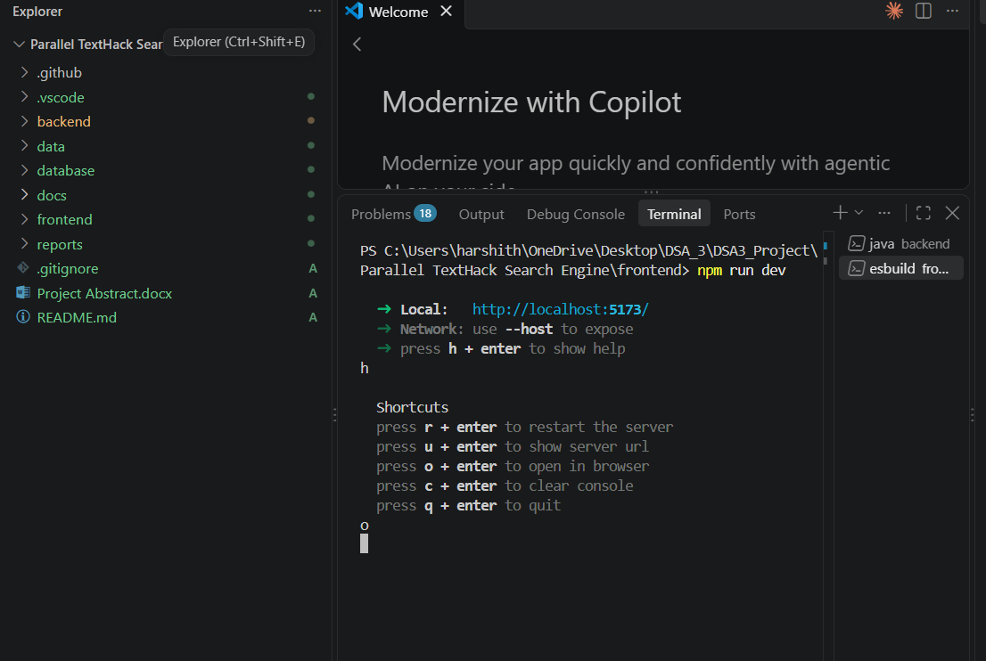
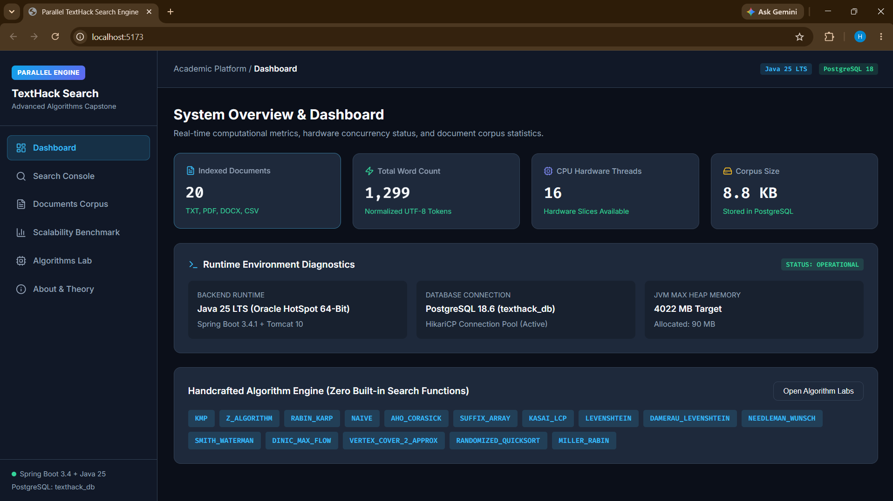
Results

Slide 12
Hardware and Software requirements
Hardware Requirements
Minimum
Processor: Dual-core CPU
RAM: 8 GB
Storage: 10 GB free space
Internet connection for dependency installation
64-bit Windows system
Recommended
Processor: Intel Core i5 / AMD Ryzen 5 or better
16 GB RAM
SSD
4+ CPU cores
20 GB+ free storage

Slide 13
Hardware and Software requirements
Software Requirements
Software | Purpose
Windows 10/11 | Operating System
VS Code | Development Environment
Java 25 | Backend and algorithms
Apache Maven | Build and dependency management
Spring Boot | Backend REST API
PostgreSQL | Database
Node.js | Frontend runtime
npm | Frontend package management
React | User interface
Git | Version control
Libraries
Apache PDFBox
Apache POI
JUnit
Charting library

Slide 14
Conclusion
The Parallel TextHack Search Engine successfully demonstrates the integration of advanced algorithms, string processing, and parallel computation for efficient document search
Parallel processing provides substantial performance improvements over sequential search, with measurable speedup and throughput gains
Advanced string-matching algorithms significantly outperform naive approaches, reducing computational overhead
The system effectively handles large document collections while providing users with ranked, relevant search results
Performance analysis validates the effectiveness of parallelization strategy and identifies optimal thread configurations

Slide 15
Future Scope
Distributed Computing: Extend parallel processing to distributed systems using frameworks like Apache Spark or Hadoop for handling massive document collections across multiple machines
GPU Acceleration: Leverage GPU computing for further performance improvements in pattern matching and document processing
Advanced Ranking: Implement machine learning-based ranking algorithms to improve result relevance beyond simple occurrence counting
Incremental Indexing: Add support for dynamic document collections with incremental indexing to avoid full re-processing
Query Optimization: Develop query optimization techniques to reduce search space and improve performance for complex multi-keyword searches
Scalability Testing: Conduct extensive testing with larger document collections and more processing threads to identify scalability limits
Real-world Applications: Deploy the system for practical use cases such as log file analysis, document management systems, or web search applications

Slide 16
Thank you

